Slide 1
Housing Price of California
Zhihao Li
Guanyu Chen
Haohan Zeng
Yunbai Zhang

Slide 2
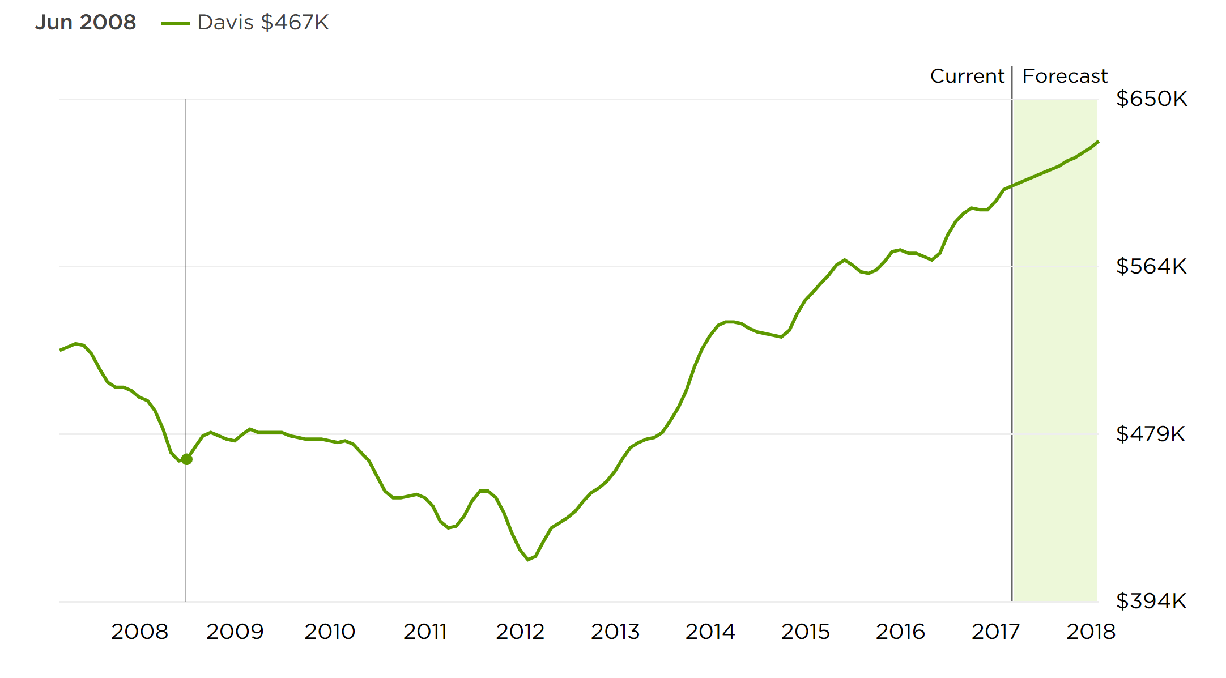

Davis Home Price Growth Trend
2008-2018

Slide 3
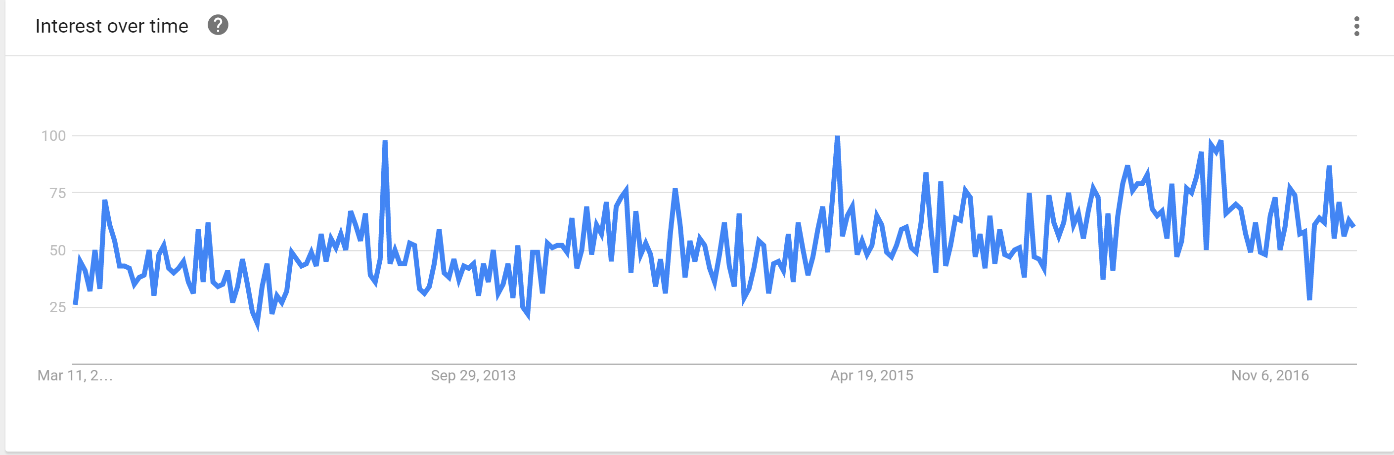
Google Trend
Housing Price from 2011-2016

Slide 4
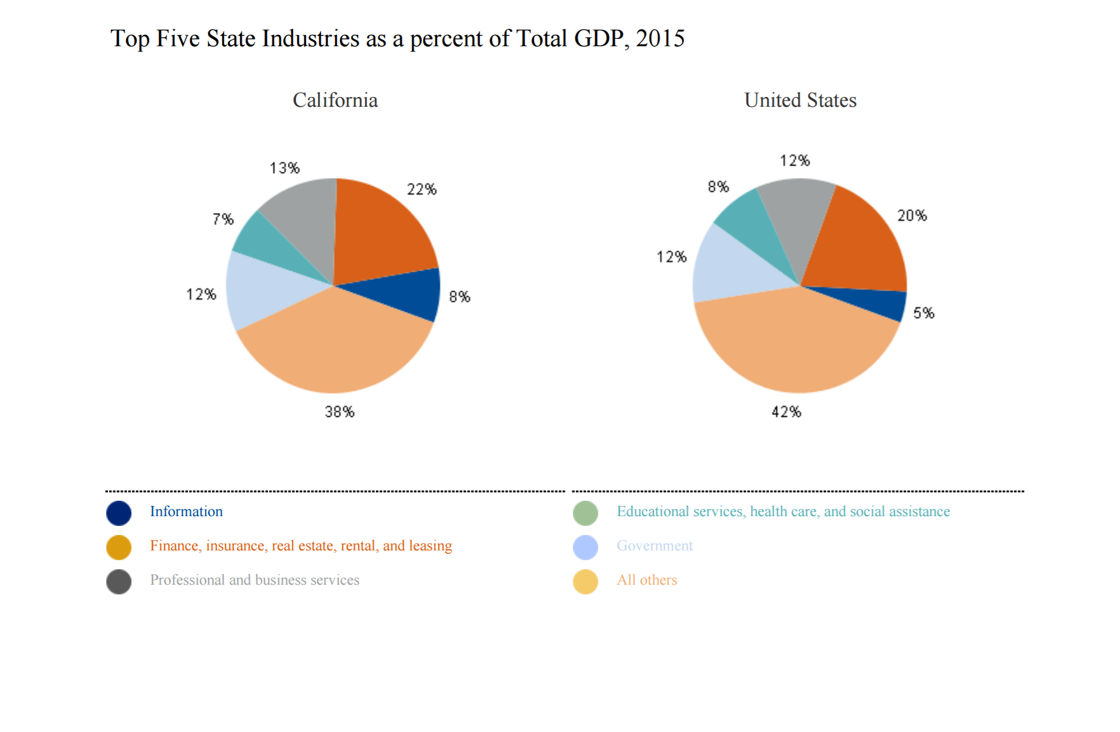
Real Estate Contributes to GDP
2015

Slide 5
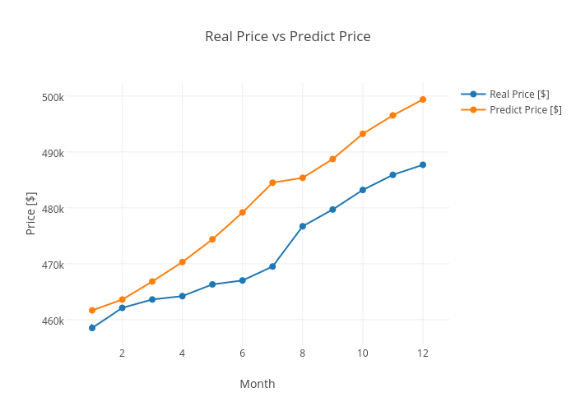
Prediction of California Housing Price
Diagnostic Of Housing Price of 2016

Slide 6
14 Largest Cities in California
2015

Slide 7
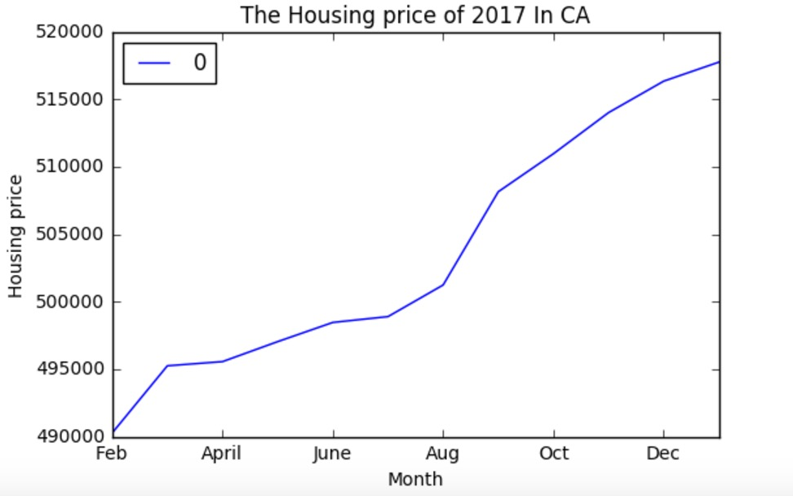
Prediction of Housing Price
2017

Slide 8
Three Factors may effect Housing Value
Housing supply and demand
Population Density
Income

Slide 9
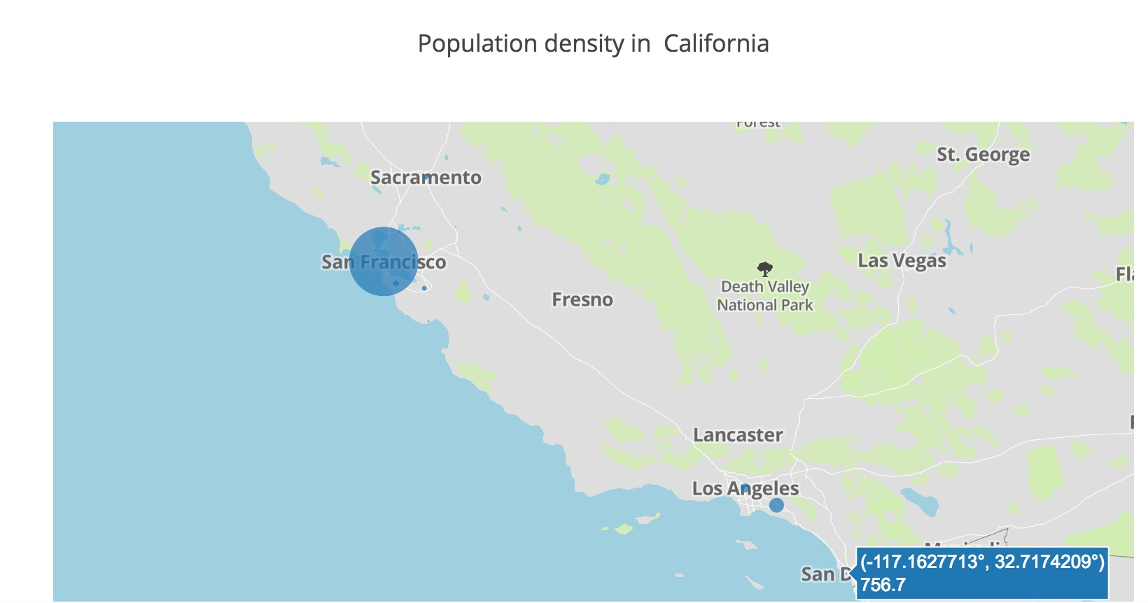
Population Density of 14 Cities
Rank

Slide 10
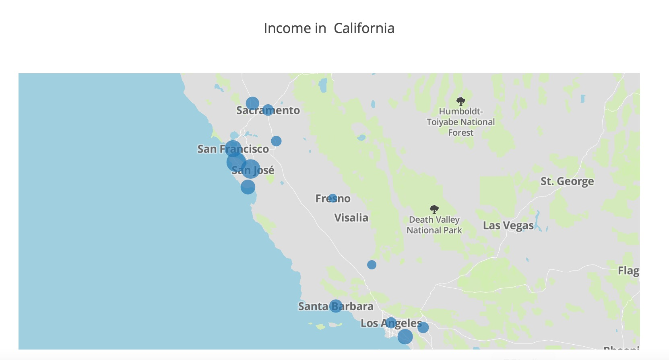
Income of 14 Cities
Rank

